Slide 1
Stock Performance of FAANG
By: Sean Lee

Slide 2
Why Study Stock Data
Dataset comes from the stock data of Facebook, Apple, Amazon, Netflix, and Google, starting from the day that these companies began to be publicly traded
https://www.kaggle.com/aayushmishra1512/faang-complete-stock-data
Data can be used to predict future economic booms and recessions
Stock information can be used to determine public opinion of a company and what policies can be enacted to improve its perception

Slide 3
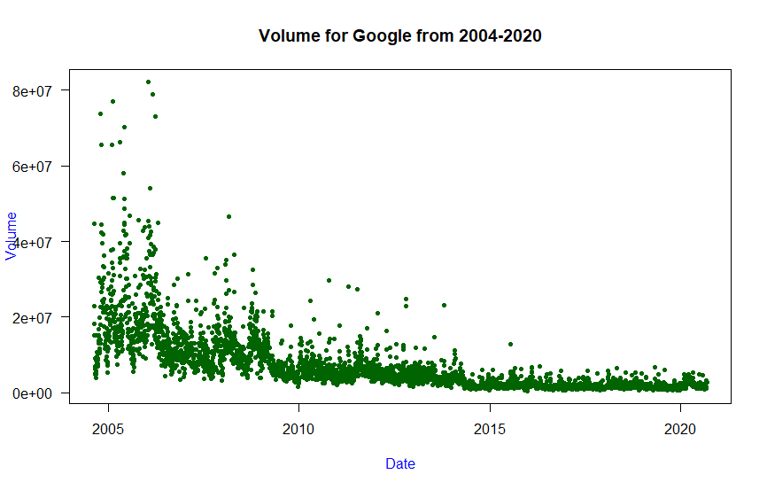
Volume
High volume is generally considered to be a sign of good performance for a stock as more people have confidence in the company and are willing to trade in greater numbers
R Code: plot(strptime(Google$Date, "%m/%d/%Y"), Google$Volume, main="Volume for Google from 2004-2020", xlab="Date", ylab="Volume", las=1, col="DarkGreen", col.lab="Blue", pch=20)

Slide 4
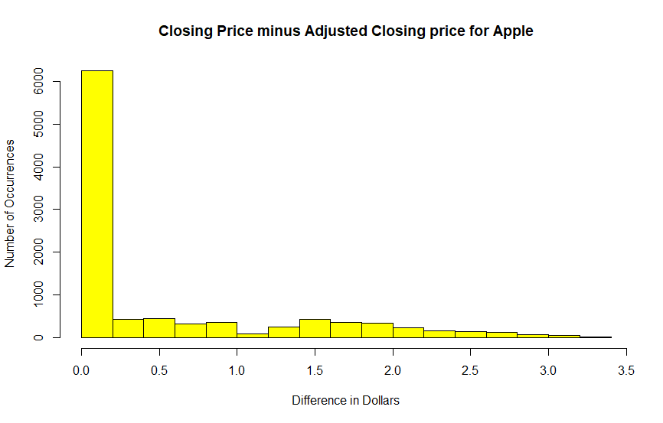
Closing vs. Adjusted Closing Price
Comparing the adjusted closing price to the closing price of a stock shows how much corporate actions such as stock splits and dividends affect the price
An adjusted closing price that matches the actual closing price of a stock means that the cash value of the stock is truly worth that amount
R Code: histvalues <- as.numeric(Apple$Close) - as.numeric(Apple$Adj.Close)
hist(histvalues, main="Closing Price minus Adjusted Closing price for Apple", xlab="Difference in Dollars", ylab="Number of Occurrences", col="Yellow")

Slide 5
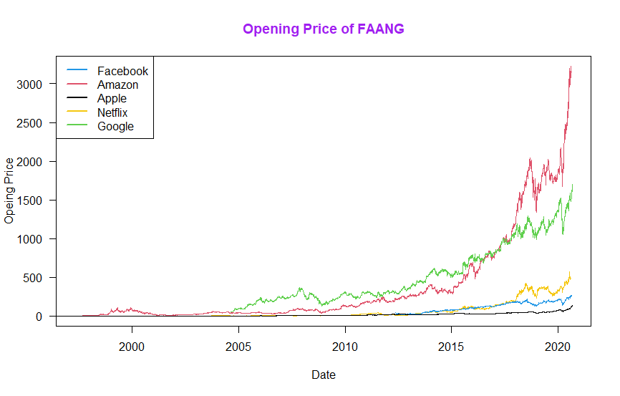
FAANG Price History
Comparing all the opening prices of FAANG shows which companies continue to be innovative while others have stagnated in their growth
R Code:
plot(strptime(Amazon$Date, "%m/%d/%Y"), Amazon$Close, main="Opening Price of FAANG", xlab="Date", ylab="Opeing Price", type="l", las=1, col="2", col.main="Purple")
lines(strptime(Google$Date, "%m/%d/%Y"), Google$Open, type="l", col="3")
lines(strptime(Netflix$Date, "%m/%d/%Y"), Netflix$Open, type="l", col="7")
lines(strptime(Facebook$Date, "%m/%d/%Y"), Facebook$Open, type="l", col="4")
lines(strptime(Apple$Date, "%m/%d/%Y"), Apple$Open, type="l", col="1")
legend(x = "topleft", legend = c("Facebook", "Amazon", "Apple", "Netflix", "Google"), lty = c(1, 1, 1, 1, 1), col = c(4, 2, 1, 7, 3), lwd = 2)

Slide 6
Conclusion
Amazon and Google both continue to experience exponential growth while Facebook, Apple, and Netflix are stagnating in their growth
The poor stock performance of Facebook, Apple, and Netflix could prompt investors to lose confidence in the stock
Executives at these companies may want to refocus their marketing strategies to promote growth

